Slide 1
Securing applications with DevOps
Wouter de Kort

Slide 2


#Technology Leaders
Architect
ALM
Ranger
Blogger
Speaker
Trainer
Microsoft MVP
Principal Consultant
Author
Elise

Slide 3
The Security Conversation
How real is the threat?
Our team is good, right?
I don’t think that’s possible.
We’ve never been breached.
Endless debates about value
Let’s talk about how we change the conversation…

Slide 4

“Fundamentally, if somebody wants to get in, they're getting in…accept that.
What we tell clients is:
Number one, you're in the fight, whether you thought you were or not. Number two,
you almost certainly are penetrated. ”
Michael Hayden
Former Director of NSA & CIA

Slide 5
The Mindset Shift
Prevent Breach
Assume Breach
Threat model
Code review
War game exercises
Security testing
Central security monitors
Security development lifecycle (SDL)
Live site penetration test

Slide 6
Cloud Mindset
Server
Services
Domain
Subscription
Domain Admin
Subscription Admin
Private IPs
Public IPs
RDP / SSH
Management APIs

Slide 7
Show, don’t tell

Slide 8
What is Red vs. Blue?
Red Team
Model
real-world attacks
Blue Team
Exercises ability to detect & respond
Identify gaps
in security story
Enhances situational awareness
Demonstrable impact
Measures readiness & impact

Slide 9
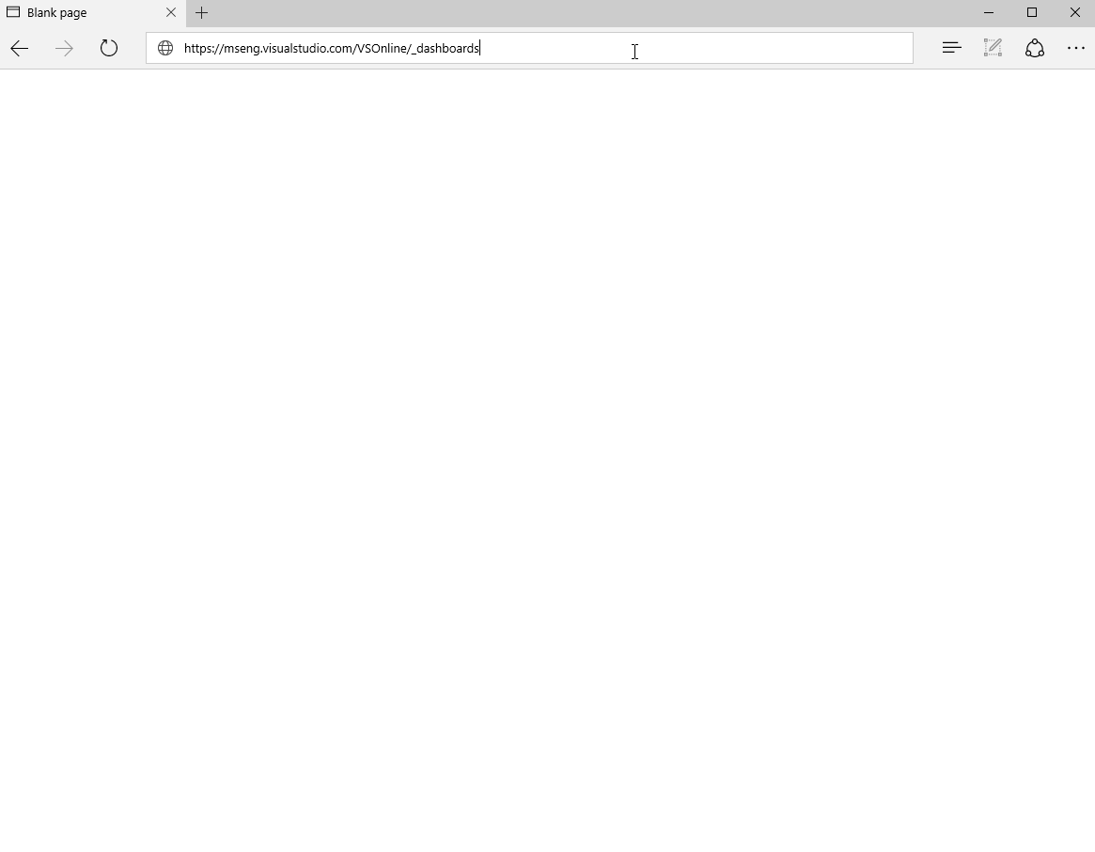
Prove it!
Show
Don’t tell

Slide 10
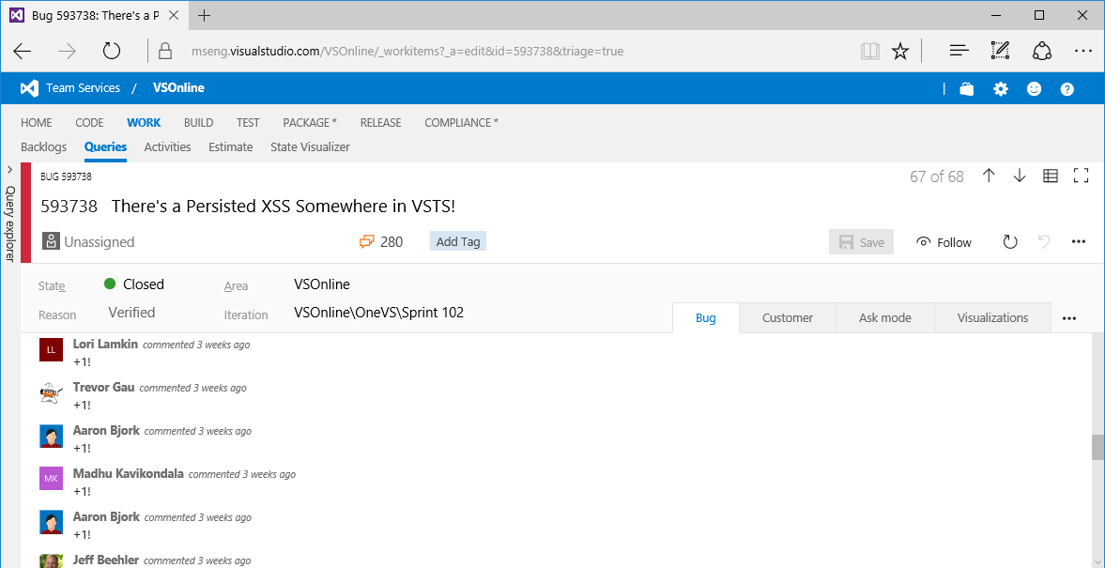
Every time someone viewed the dashboard…

Slide 11
Sample Guidelines
Code of Conduct
  Both the Blue Team and the Red Team will do no harm.
  The Red Team should not compromise more than needed to capture target assets.
  Common sense rules apply to physical attacks (no printing badges, harassing people, etc.)
  Do not disclose the name of the person who was compromised in a social engineering attack.
Rules of Engagement
  Do not impact availability of any system.
  Do not access external customer data.
  Do not significantly weaken in-place security protections on any service.
  Do not intentionally perform destructive actions against any resources.
  Safeguard credentials, vulnerabilities and other critical information obtained.
Deliverables
  Backlog of repair items (security item SLA)
  Report “read out” with entire organization as a learning opportunity.

Slide 12
Sample Attacks

Slide 13
“Defenders think in lists. Attackers think in graphs. As long as this is true, attackers win”
John Lambert (MSTIC)

Slide 14
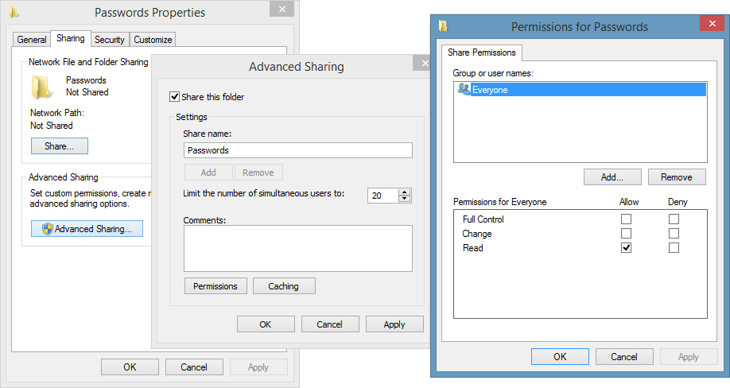
Example: Red Team Attack
What does an unprotected file share look like?

Slide 15
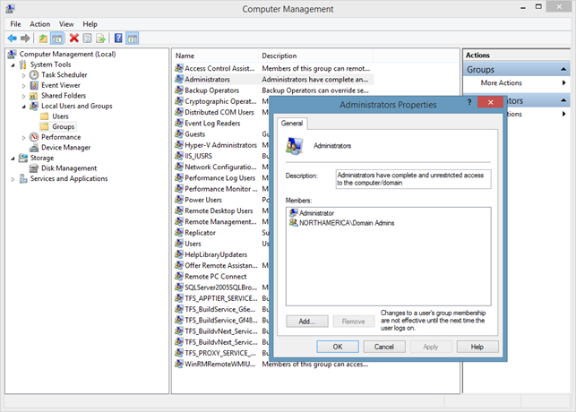
Example: Red Team Attack
Who is a Local Administrator on your machines?

Slide 16
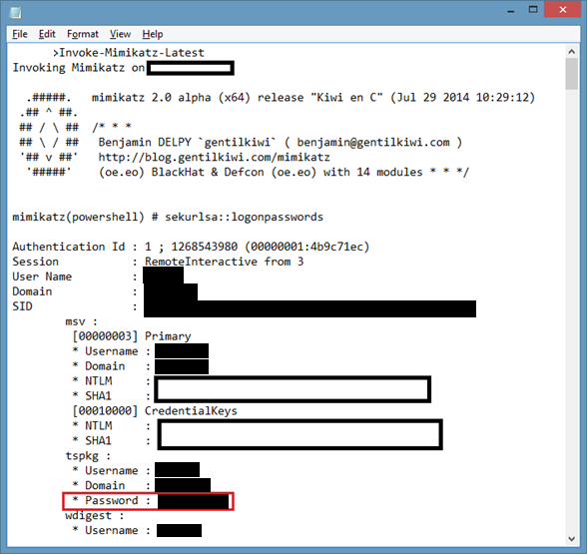
Example: Red Team Attack
Introducing Mimikatz
Tool written by a French security researcher (external to Microsoft).
Extracts passwords, keys, pin codes, tickets from the memory of lsass.exe (Local Security Authority Subsystem Service).
Requires debug privilege or SYSTEM account (aka, Local Administrator access)

Slide 17
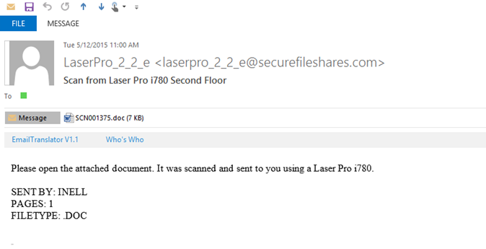
Example: Phishing to get credentials
524 Recipients
103 people opened attachment (19%)
10 people reported (2%)

Slide 18
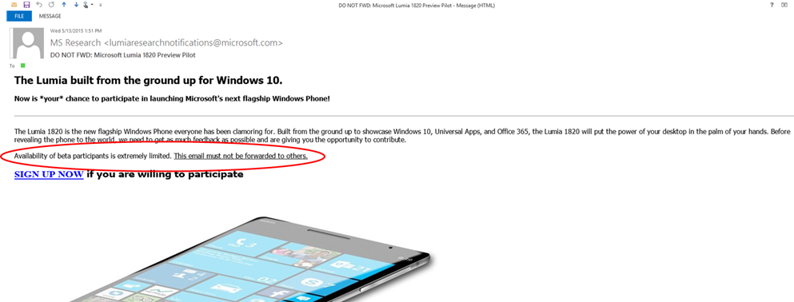
Example: Better phishing
524 Recipients
220 people clicked sign up (42%). 37 clicked both emails
11 people reported to IT Security (2%)

Slide 19
How to respond?

Slide 20
Threat Modeling
A way to identify security issues during design
Developers think about how a product works
Attackers think about how to abuse a product
Shift the mindset
Think like an attacker

Slide 21
Defense in depth
Attackers chain vulnerabilities together
Move from one system to another
Assume layers before yours will be breached
Never assume an internal service is unimportant

Slide 22
What does a Threat Model include?
Use cases
Data Flow Diagrams
Components and the data flowing between them
Entry points
Trust boundaries
Assets to be protected
Threats, mitigations and accepted risks
Security assumptions
Often about systems you depend on
Databases, Servers, Keys
Of the system being modeled

Slide 23

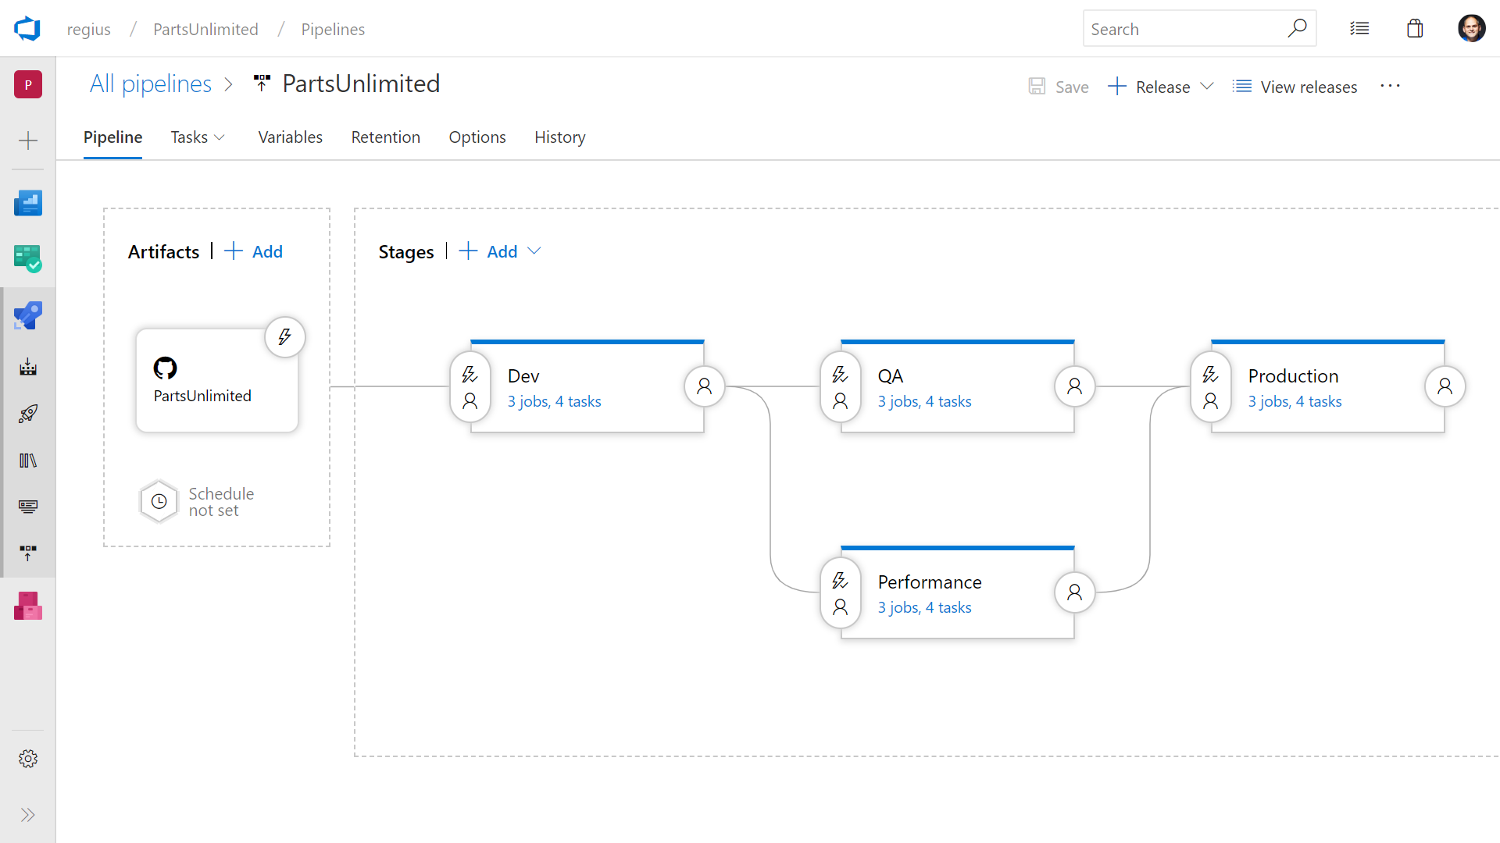
One pipeline to rule them all
➔
https://azure.com/devops

Slide 24


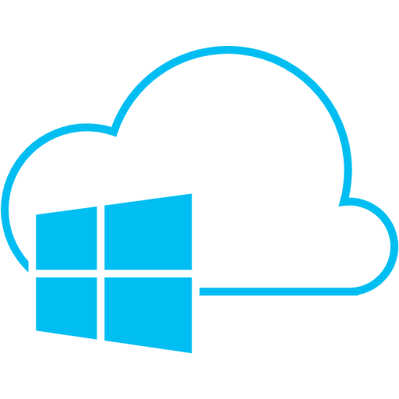
End to End
Feature Flags
Code Repository
Build + Deploy
Testing
User Feedback
Process
Monitor and improve

Slide 25
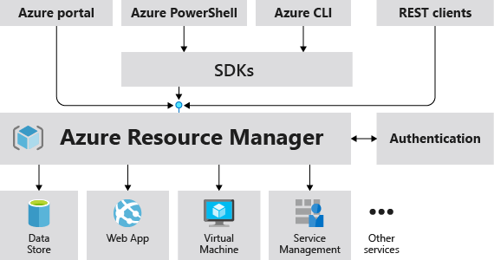
Everything as Code
"resources": [
{
"apiVersion": "2016-01-01",
"type": "Microsoft.Storage/storageAccounts",
"name": "mystorageaccount",
"location": "westus",
"sku": {
"name": "Standard_LRS"
},
"kind": "Storage",
"properties": {
}
}
]

Slide 26
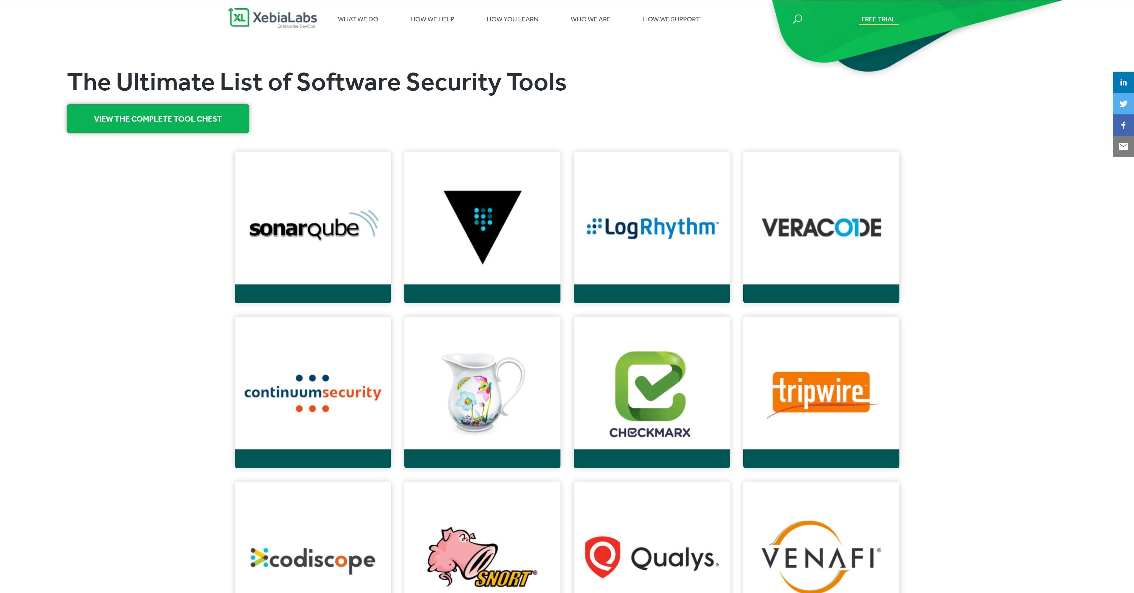

Slide 27
Desired State Configuration
Configuration ContosoWebsite
{
param ($MachineName)
Node $MachineName
{
#Install the IIS Role
WindowsFeature IIS
{
Ensure = “Present”
Name = “Web-Server”
}
#Install ASP.NET 4.5
WindowsFeature ASP
{
Ensure = “Present”
Name = “Web-Asp-Net45”
}
}
}
Enable management of (virtual) machines
Pull or push model
Detect configuration drift

Slide 28
No secrets in code: Azure Key Vault
All secrets must be stored in AKV:
Passwords, keys, tokens
Storage Account keys
Certificates
Credentials used in Test too
Hierarchy of vaults to eliminate duplication of secrets.
Vaults available at run-time so that secret changes propagate instantly.
Service Instance
Run-time vaults
Deploy-time vaults
Service-wide vault
Global vault
Deployment-specific vault
Service-wide vault
Global vault
Deployment-specific vault

Slide 29
Managed Identies
using Microsoft.Azure.Services.AppAuthentication;
using Microsoft.Azure.KeyVault;
// ...
var azureServiceTokenProvider = new AzureServiceTokenProvider();
string accessToken = await azureServiceTokenProvider.GetAccessTokenAsync("https://vault.azure.net");

Slide 30
Networking
Virtual Networks
Avoid Public IPs
Azure Front Door with Web Application Firewall

Slide 31
Assume breach

Slide 32
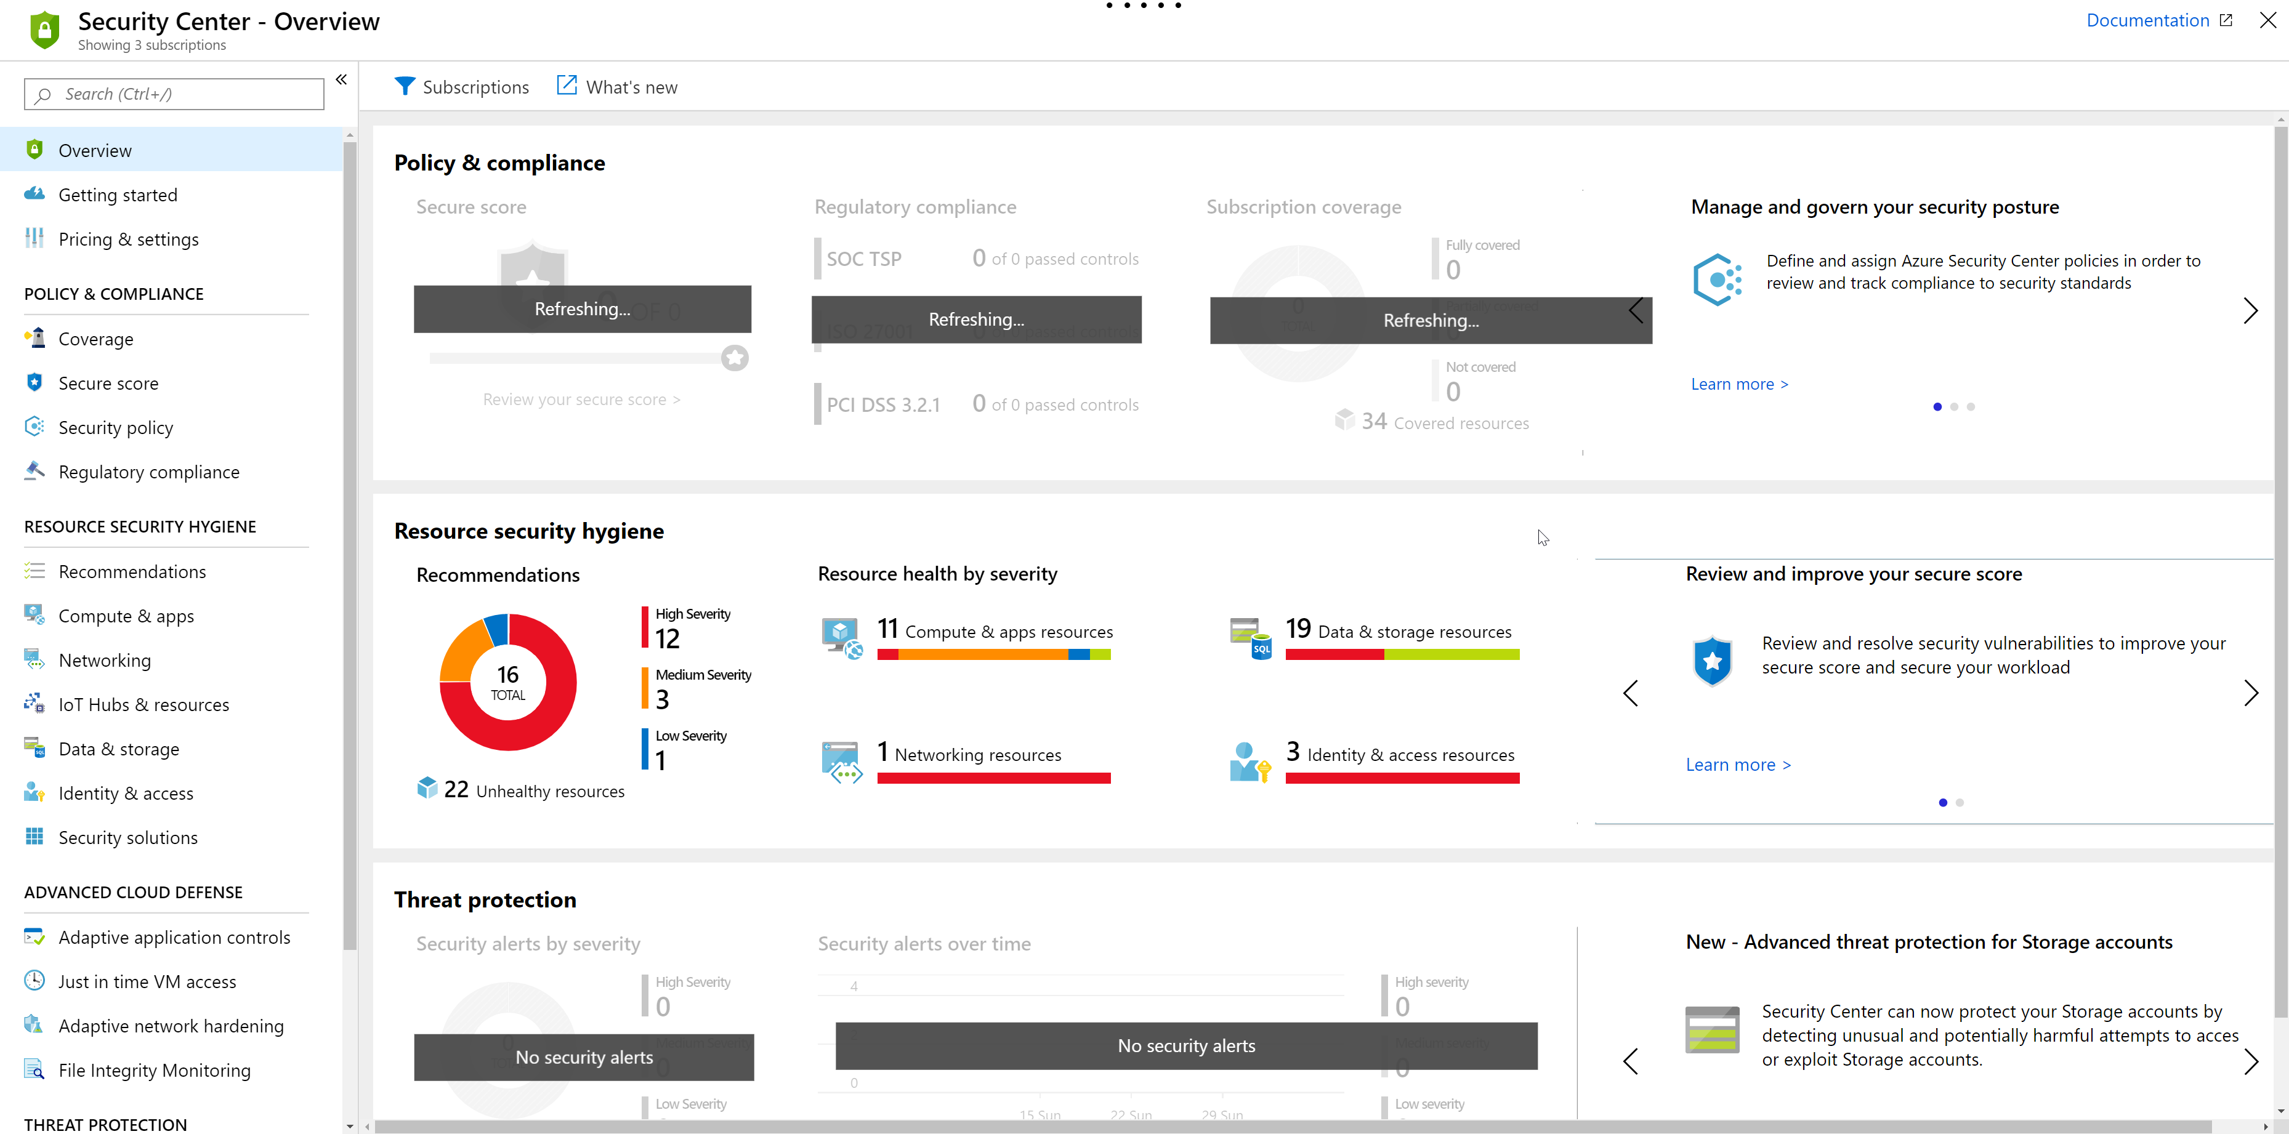
Azure Security Center

Slide 33
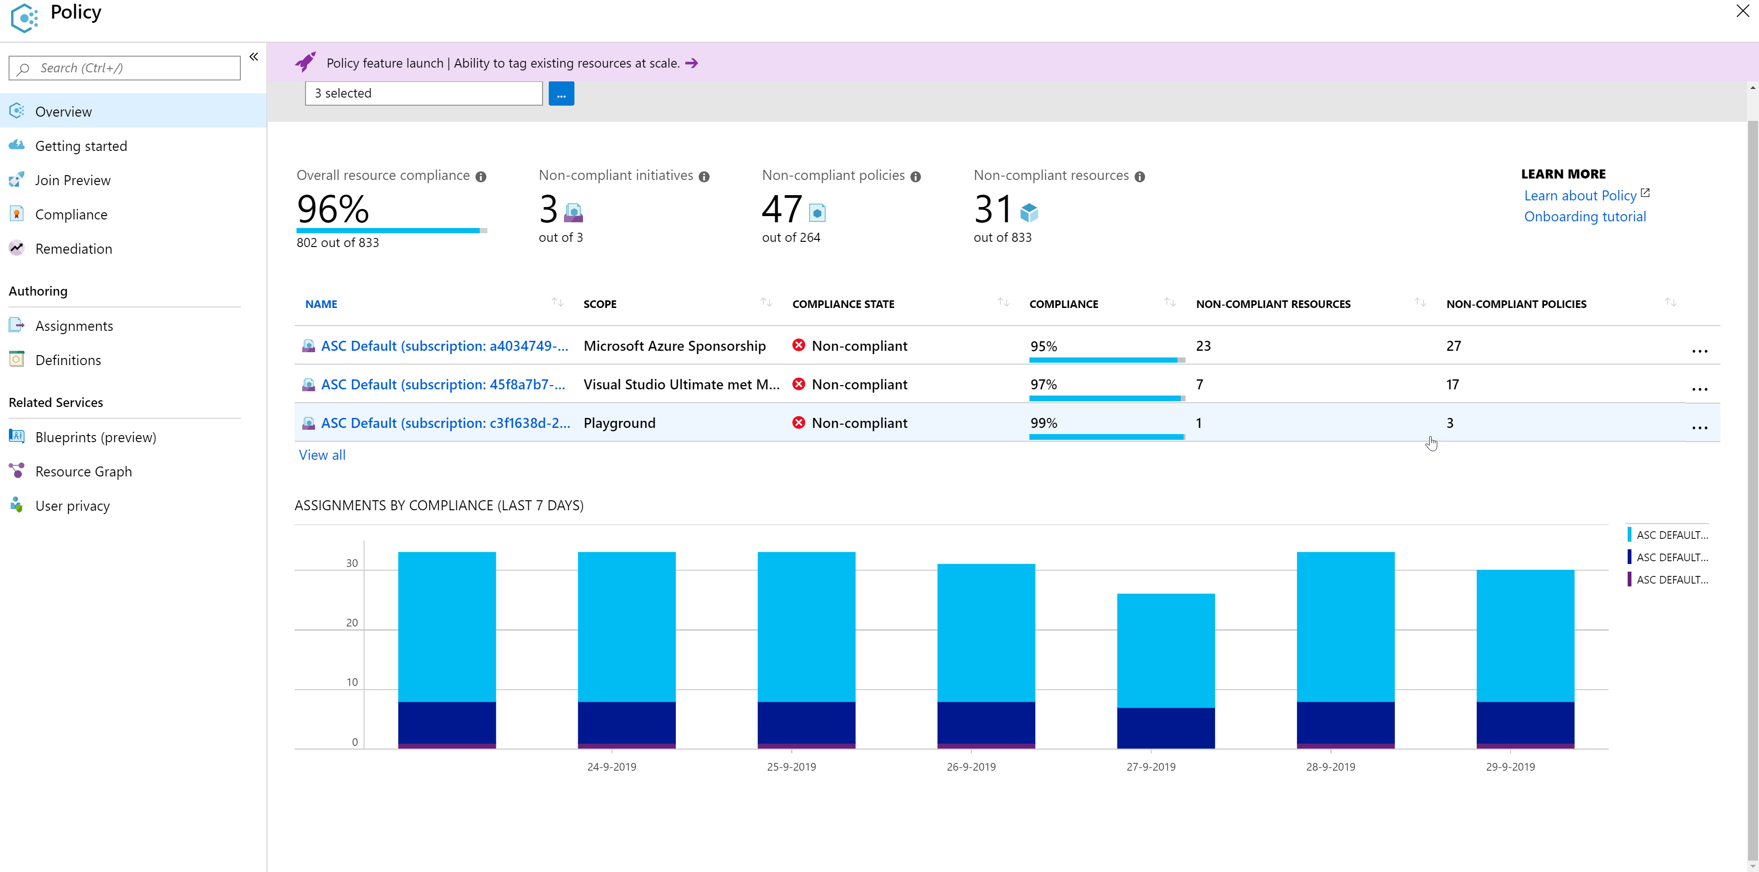
Azure Policy

Slide 34
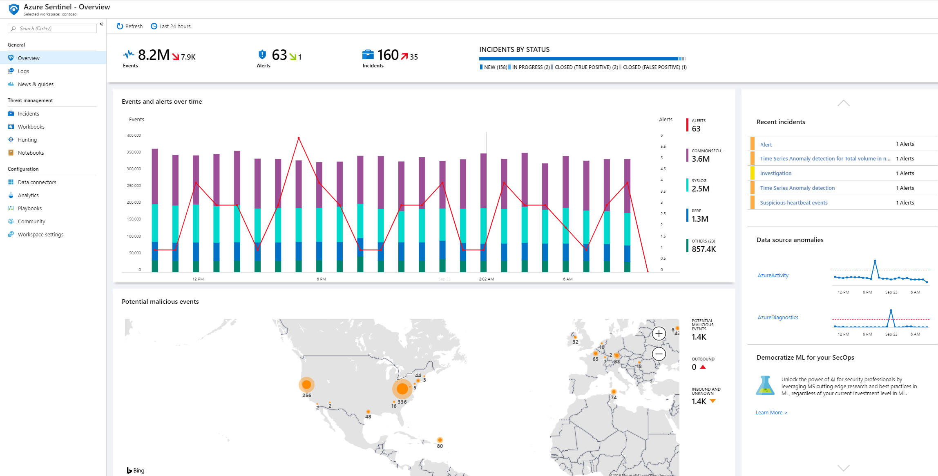
Azure Sentinel

Slide 35
Demo!

Slide 36
GitHub

Slide 37
Software Composition Analysis
Open Source
60% - 80%
Proprietary
10%-20%
+
+
Commercial
10-20%
*Gartner User Survey Analysis: Open-Source Software 2016 & Forrester Wave Report: Software Composition Analysis, Q1, 2017

Slide 38




Open Source Introduces New Challenges
Security
Licenses
Quality
Versions

Slide 39
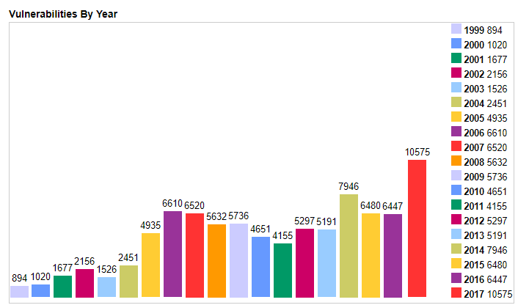
Vulnerabilities by year

Slide 40
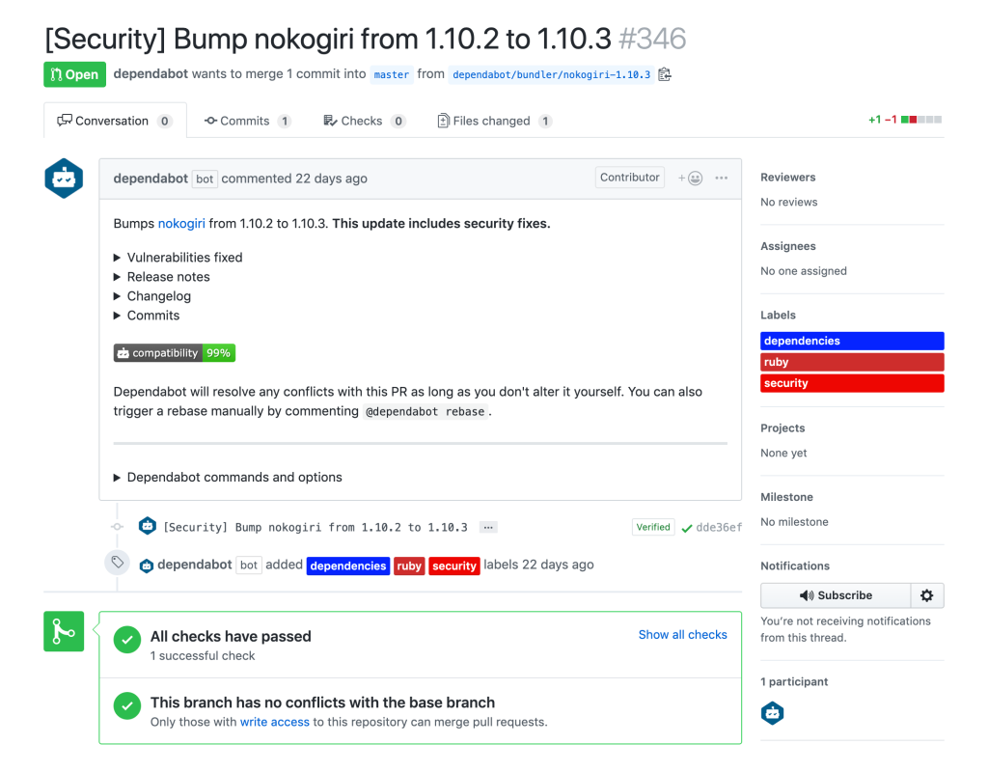
GitHub Secure Coding

Slide 41
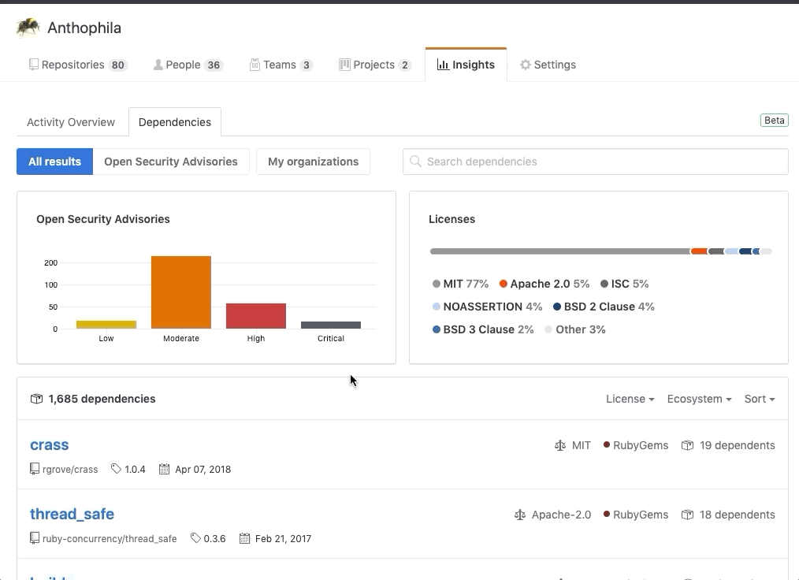
GitHub Secure Coding

Slide 42
Recap
Deployment pipeline
Infrastructure as Code
Azure Key Vault
Managed Identities
Static Analysis
Runtime monitoring
Azure Security Center
Azure Sentinel
Red vs Blue
Shift left
GitHub

Slide 43
Don’t take your on-premises security to the cloud

Slide 44
Thank you!

Slide 45




Get in touch!
@wouterdekort
wouter@wouterdekort.com
https://wouterdekort.com

